Slide 1
Data Mining: Data
Lecture Notes for Chapter 2
Introduction to Data Mining , 2nd Edition
by
Tan, Steinbach, Kumar

Slide 2
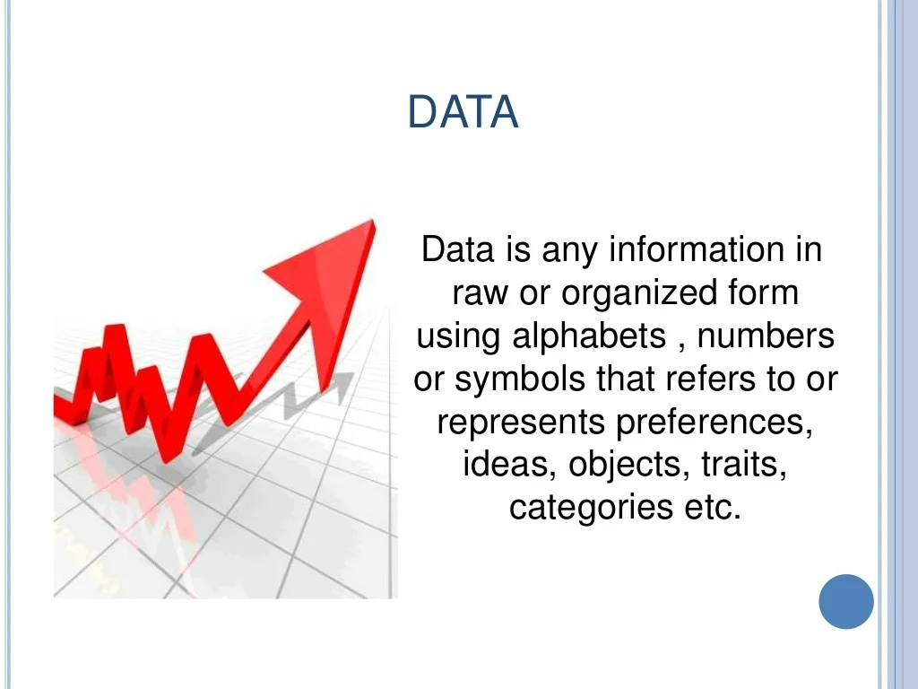
What is Data?

Slide 3
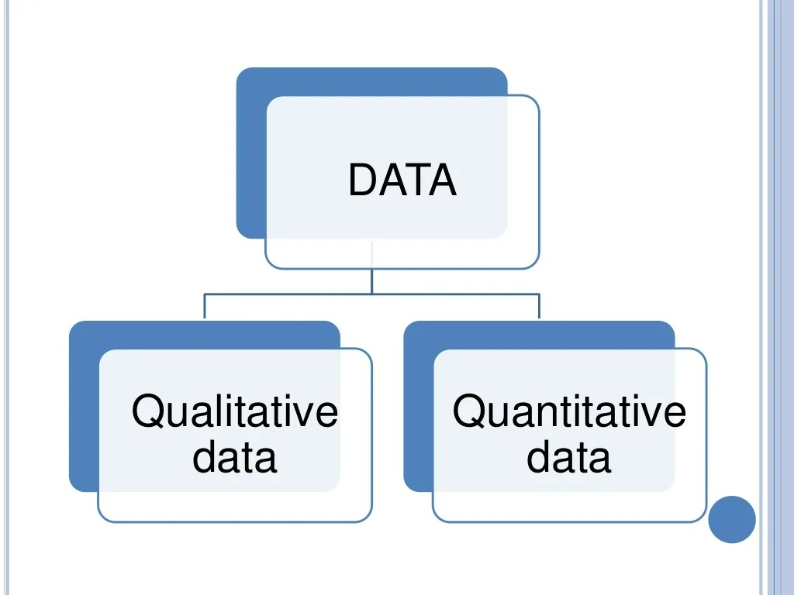

Slide 4
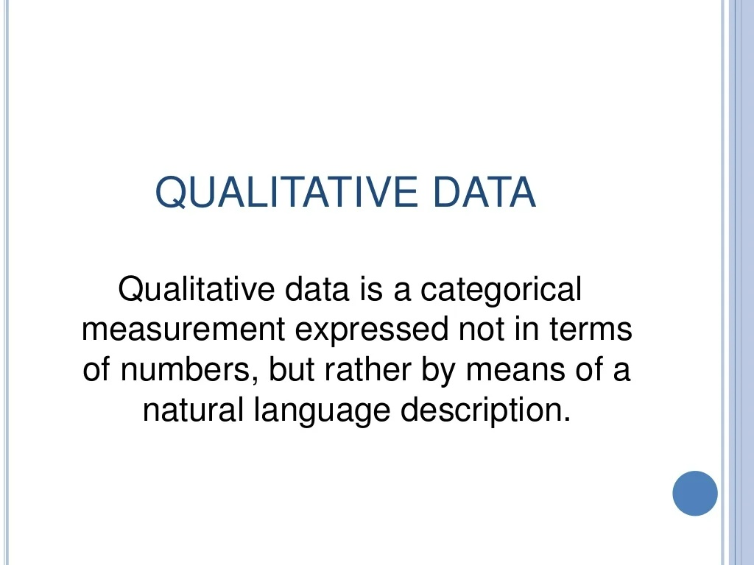

Slide 5
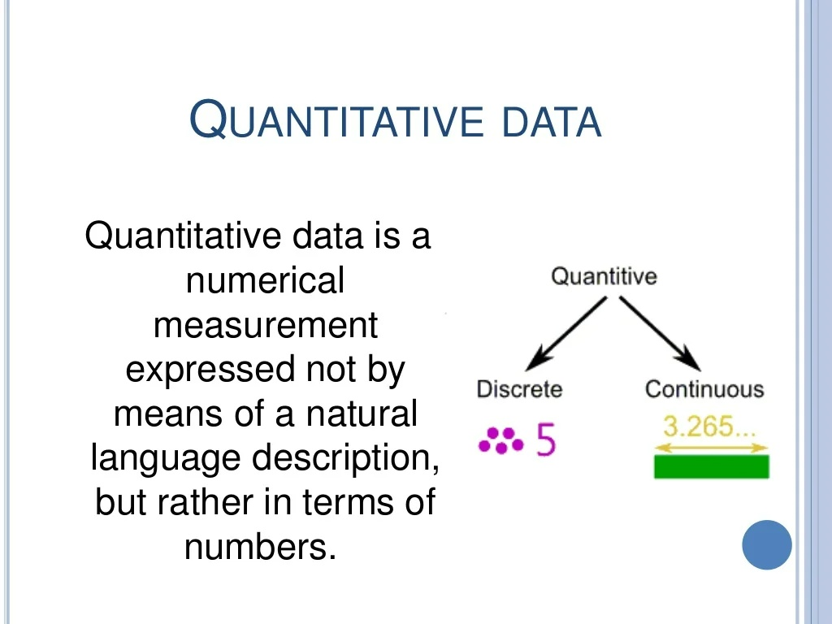

Slide 6
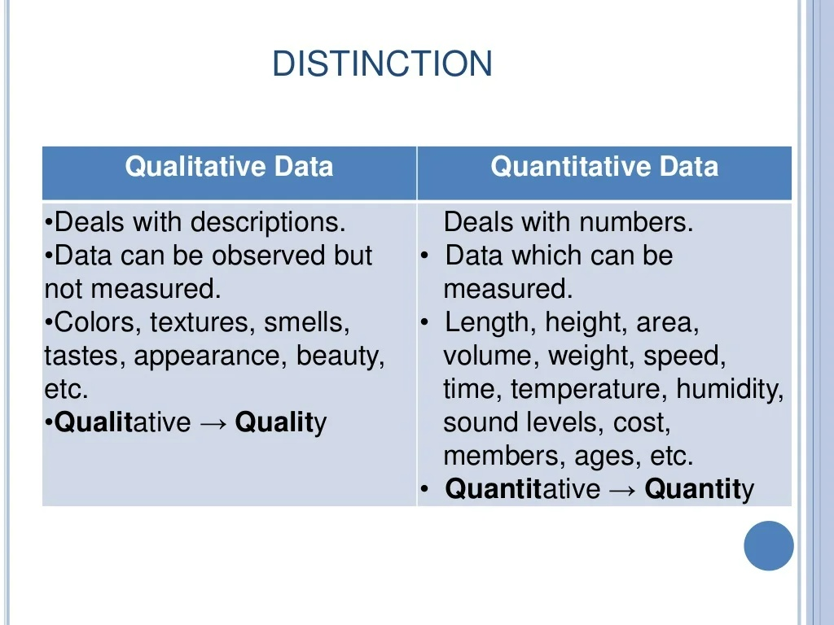

Slide 7
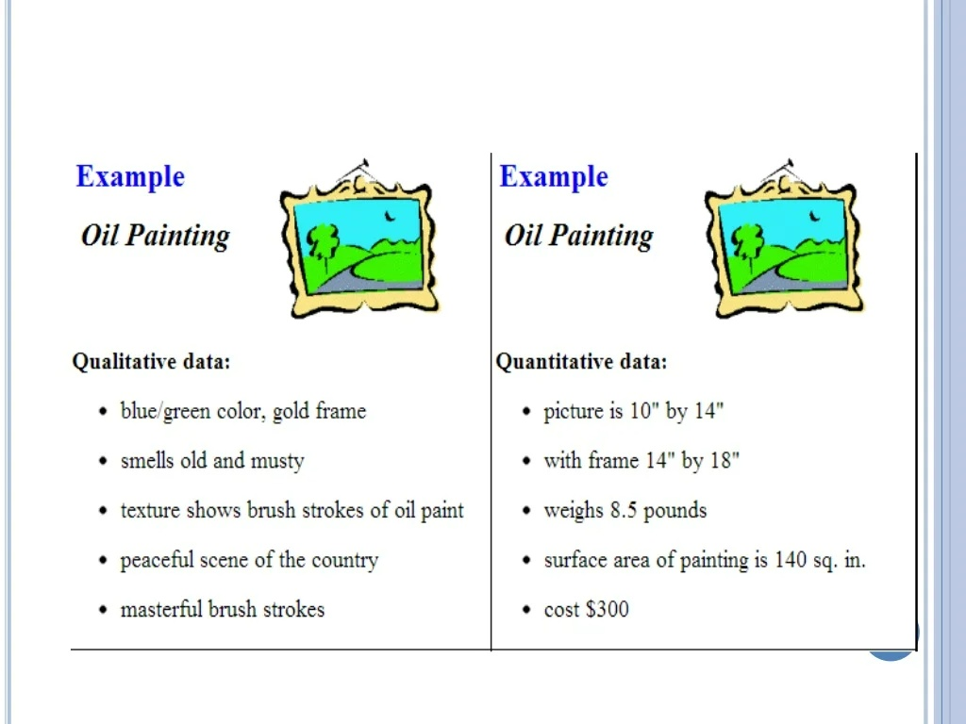

Slide 8
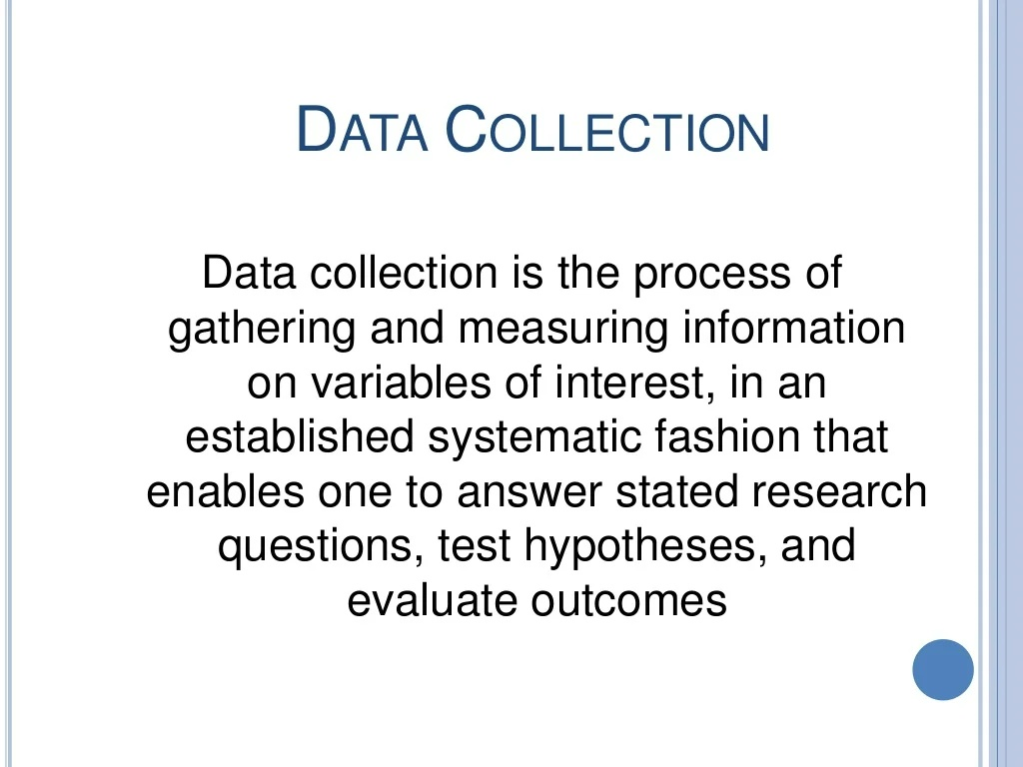

Slide 9
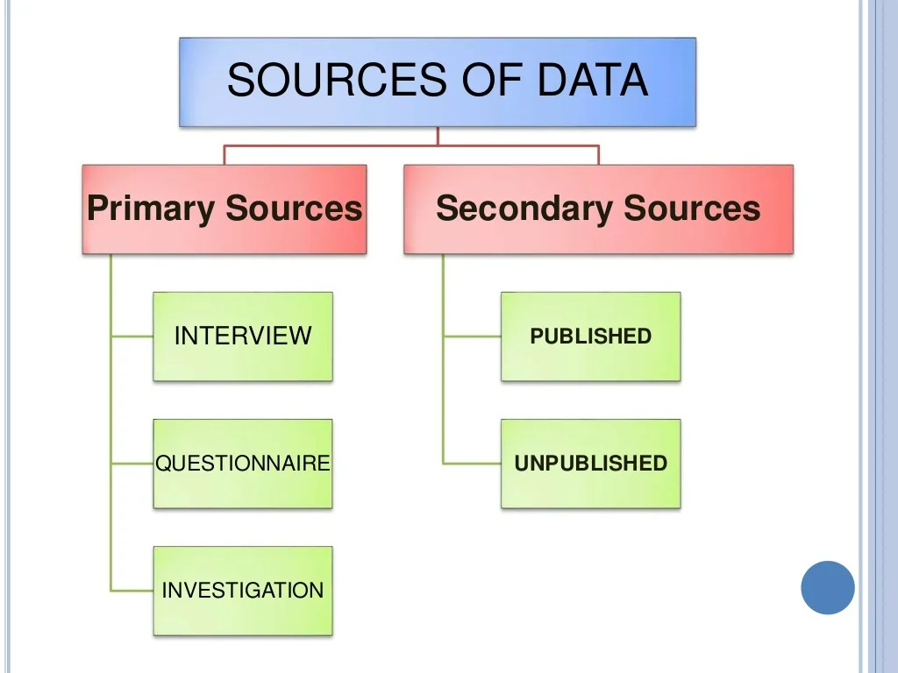

Slide 10
Data collection
The collection method also depends upon the type of data that is being collected:
Images data: might be collected by smartphone cameras, professional cameras or microscopic images
Sound data might be collected using various recording tools
Signals: might be collected using more professional equipment. i.e., earthquake data.

Slide 11
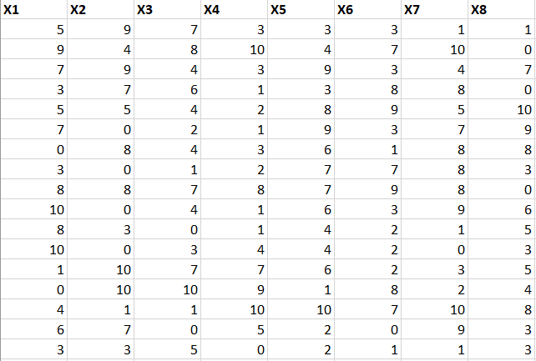
Example of a dataset
In our course, we will deal with tabular datasets.

Slide 12
What is Data?
Collection of data objects and their attributes
An attribute is a property or characteristic of an object
Examples: eye color of a person, temperature, etc.
Attribute is also known as variable, field, characteristic, dimension, or feature
A collection of attributes describe an object
Object is also known as record, point, case, sample, entity, or instance
Attributes
Objects

Slide 13
Attribute Values
Attribute values are numbers or symbols assigned to an attribute for a particular object
Distinction between attributes and attribute values
Same attribute can be mapped to different attribute values
Example: height can be measured in feet or meters
Different attributes can be mapped to the same set of values
Example: Attribute values for ID and age are integers
But properties of attribute can be different than the properties of the values used to represent the attribute

Slide 14
Types of Attributes
There are different types of attributes
Nominal
Examples: ID numbers, eye color, zip codes
Ordinal
Examples: rankings (e.g., taste of potato chips on a scale from 1-10), grades, height {tall, medium, short}
Interval
Examples: calendar dates, temperatures in Celsius or Fahrenheit.
Ratio
Examples: temperature in Kelvin, length, counts, elapsed time (e.g., time to run a race)

Slide 15
This categorization of attributes is due to S. S. Stevens

Slide 16
This categorization of attributes is due to S. S. Stevens

Slide 17
Discrete and Continuous Attributes
Discrete Attribute
Has only a finite or countably infinite set of values
Examples: zip codes, counts, or the set of words in a collection of documents
Often represented as integer variables.
Note: binary attributes are a special case of discrete attributes
Continuous Attribute
Has real numbers as attribute values
Examples: temperature, height, or weight.
Practically, real values can only be measured and represented using a finite number of digits.
Continuous attributes are typically represented as floating-point variables.

Slide 18
Data Mining
Data Preprocessing

Slide 19
Data Common problems
Problems might occur while collecting the data
Missing data
Redundant data records
Data attributes with different scale
Noise/Outliers
High dimensional data

Slide 20
Missing data
Cleaning the missing data helps in creating an accurate models
Several methods are used to fix the missing data problem.
Delete records which has missing values (NAN/NA)
Replace the missing data values with an alternative value (mean/median/mode
Interpolation

Slide 21
Deletion (Practice using python)
Download the following dataset from kaggle: https://www.kaggle.com/datasets/uciml/breast-cancer-wisconsin-data
Open googlecolab and practice

Slide 22
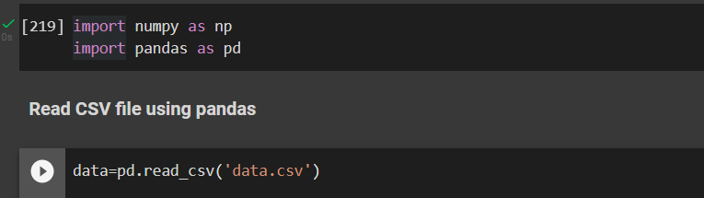
Read the dataset

Slide 23
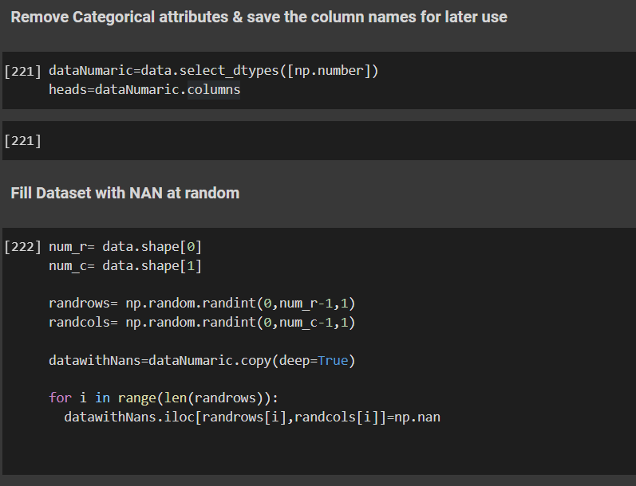
Fill with NaNs
For practical purposes, if the data has no NaNs, we can make some

Slide 24
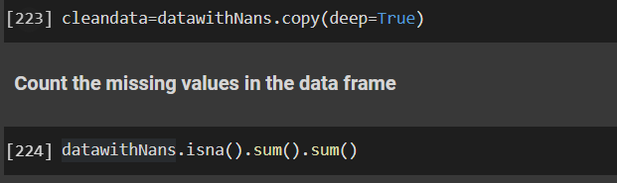

Slide 25
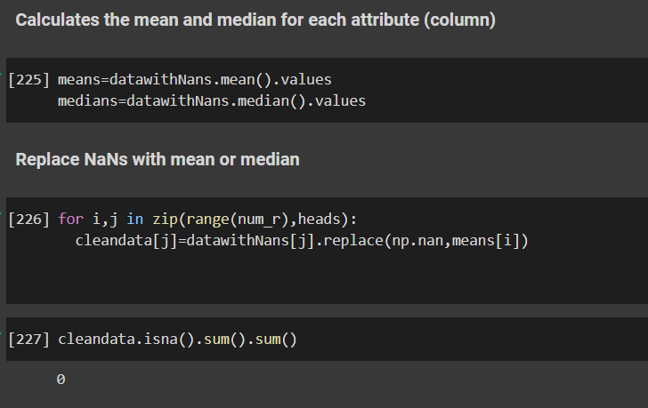
Replace NaNs
We can replace the NaN values with other statistical values, like mean, median or mode

Slide 26
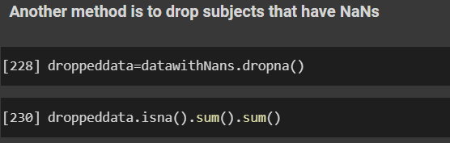
Drop records
We can simply get ride of the problematic subjects
Might be risky as it results in loss of information if the NaNs are too much and the data is small

Slide 27
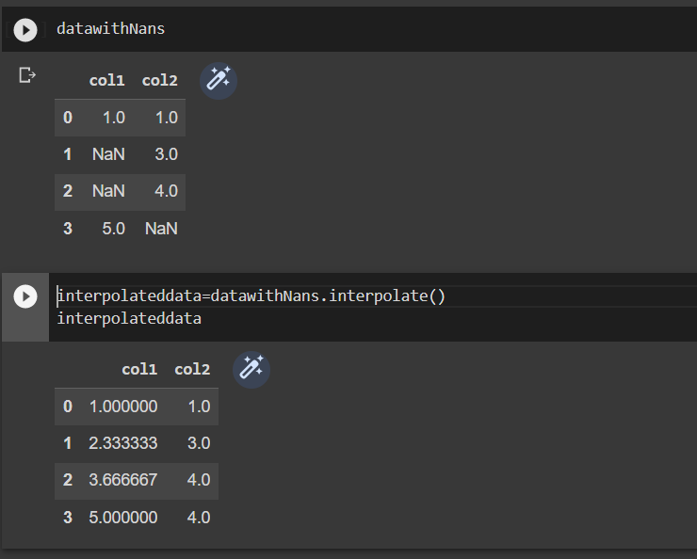
Interpolation
The most common is to perform linear interpolation to find the missing values

Slide 28
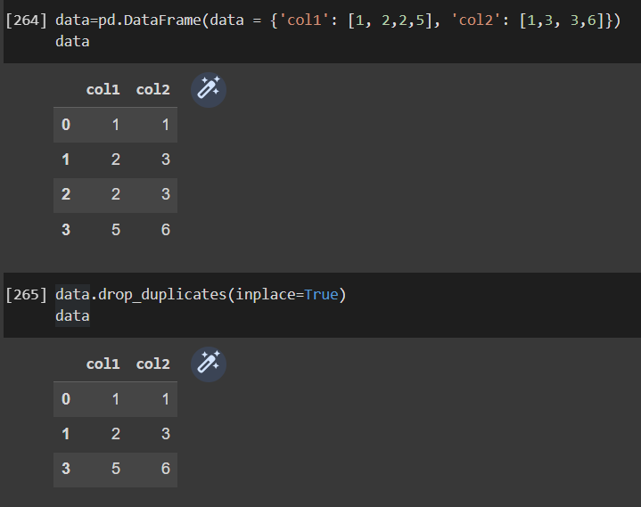
Remove duplicates
Duplicates do not add any new information
Many duplicates slow down the analysis of the data
We can remove the duplicates using a simple function in python/pandas
df.drop_duplicates()

Slide 29
Data Normalization
Attributes with different scales might result in various problem when applying machine learning
dominant feature problem in KNN classifier
slow convergence in ANNs
Example of different scale data is shown in the table below
X2 is a problematic attribute
X1 | X2 | X3 | X4
0.2 | 5 | 0.1 | 0.3
0.66 | 100 | 0.7 | 0.77
0.24 | 20 | 0.94 | 0.1
0.75 | 120 | 0.57 | 0.63

Slide 30
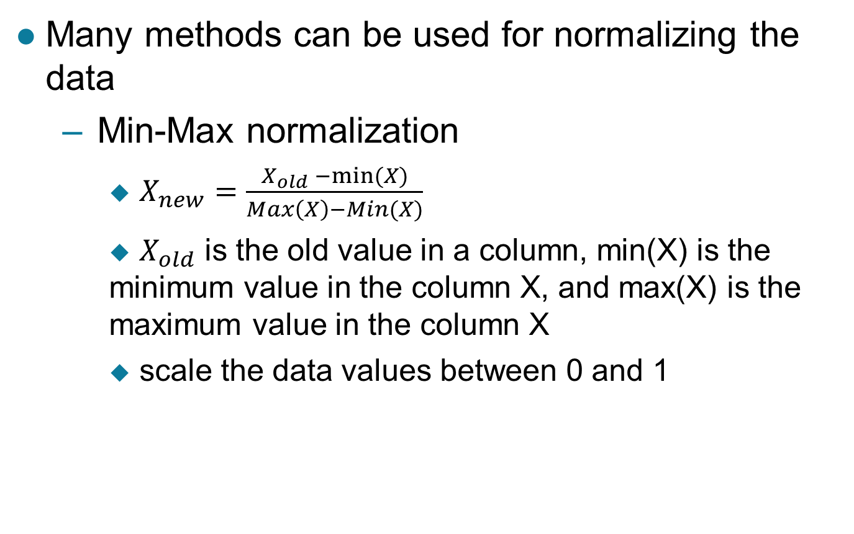
Data normalization

Slide 31
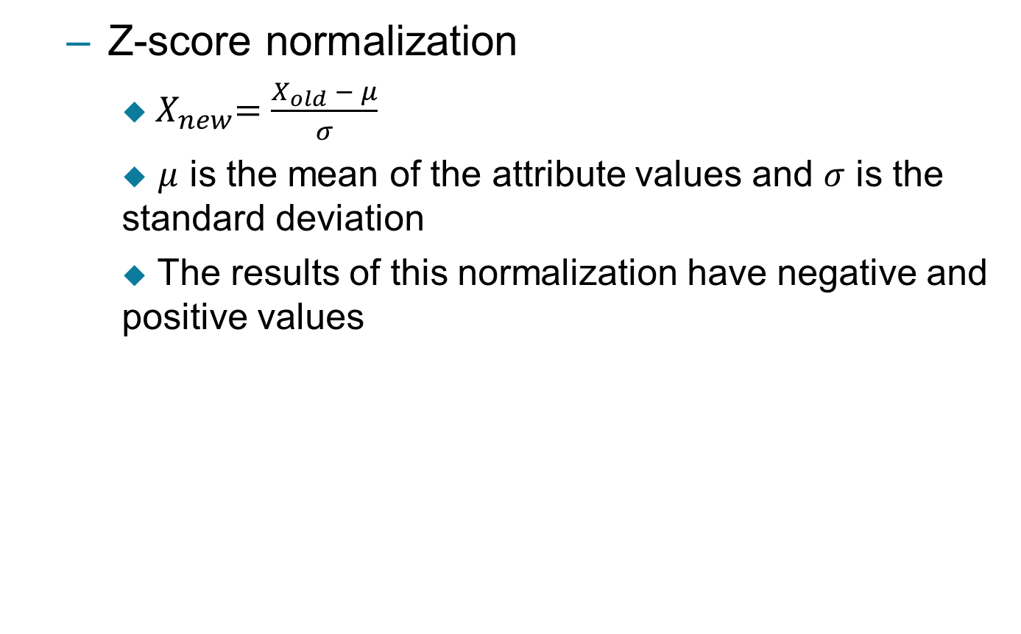
Data normalization

Slide 32
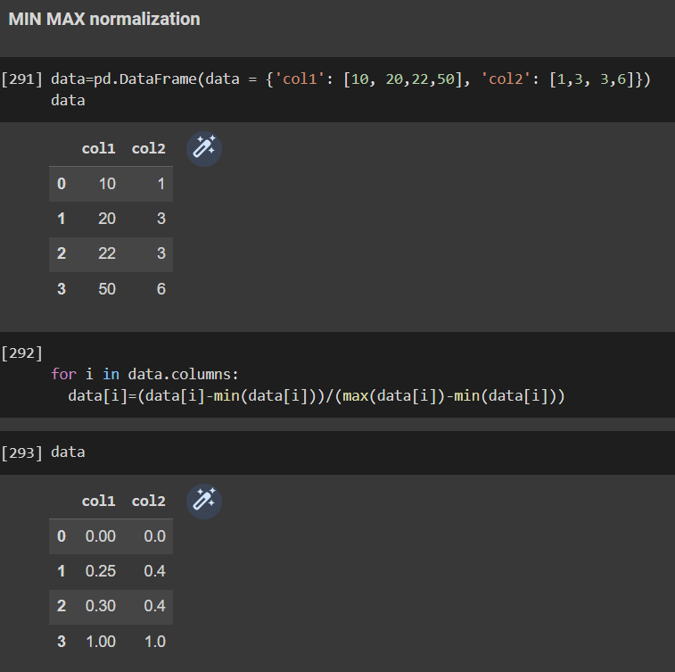
Data normalization (Python)

Slide 33
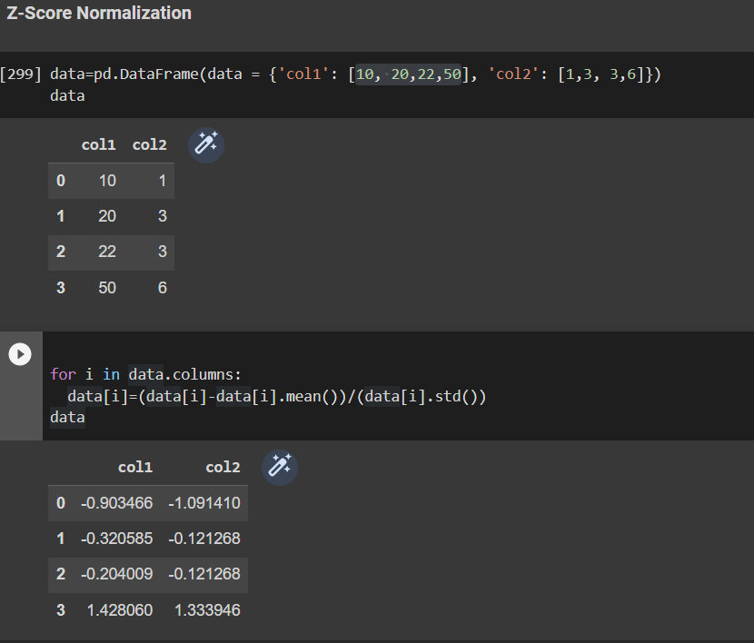
Data normalization (Python)

Slide 34
What is data dimensionality
The term dimensionality refers to the number of attributes (features) in the dataset
The dataset in the table below has dimensionality of 4
X1 | X2 | X3 | X4
0.2 | 5 | 0.1 | 0.3
0.66 | 100 | 0.7 | 0.77
0.24 | 20 | 0.94 | 0.1
0.75 | 220 | 0.57 | 0.63

Slide 35
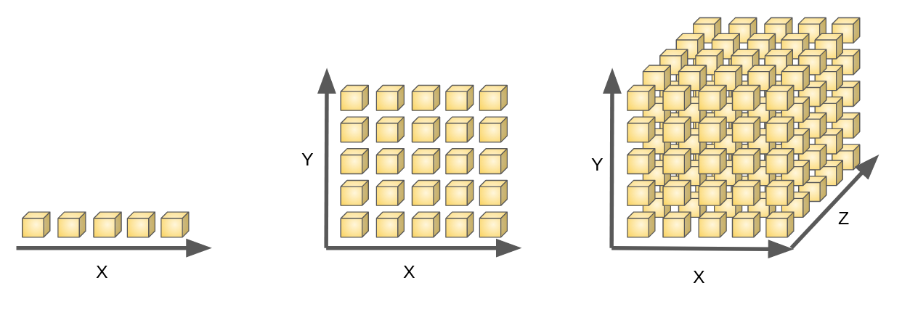
Cont.
High dimensional data has lots of drawbacks in ML and DM
Slows the analysis and train ML models
Curse of dimensionality in ML
As the number of features grows, the number samples needed grows exponentially

Slide 36
Dimensionality reduction
Dimensionality reduction is the process of decreasing the number of features while maintaining the performance of the ML/DM system
Reducing the number of dimensionality is not done arbitrarily.
One popular method is called principal component analysis (PCA)
Feature selection is a good for dimensionality reduction and enhancing the performance
We select the features that results in good performance

Slide 37
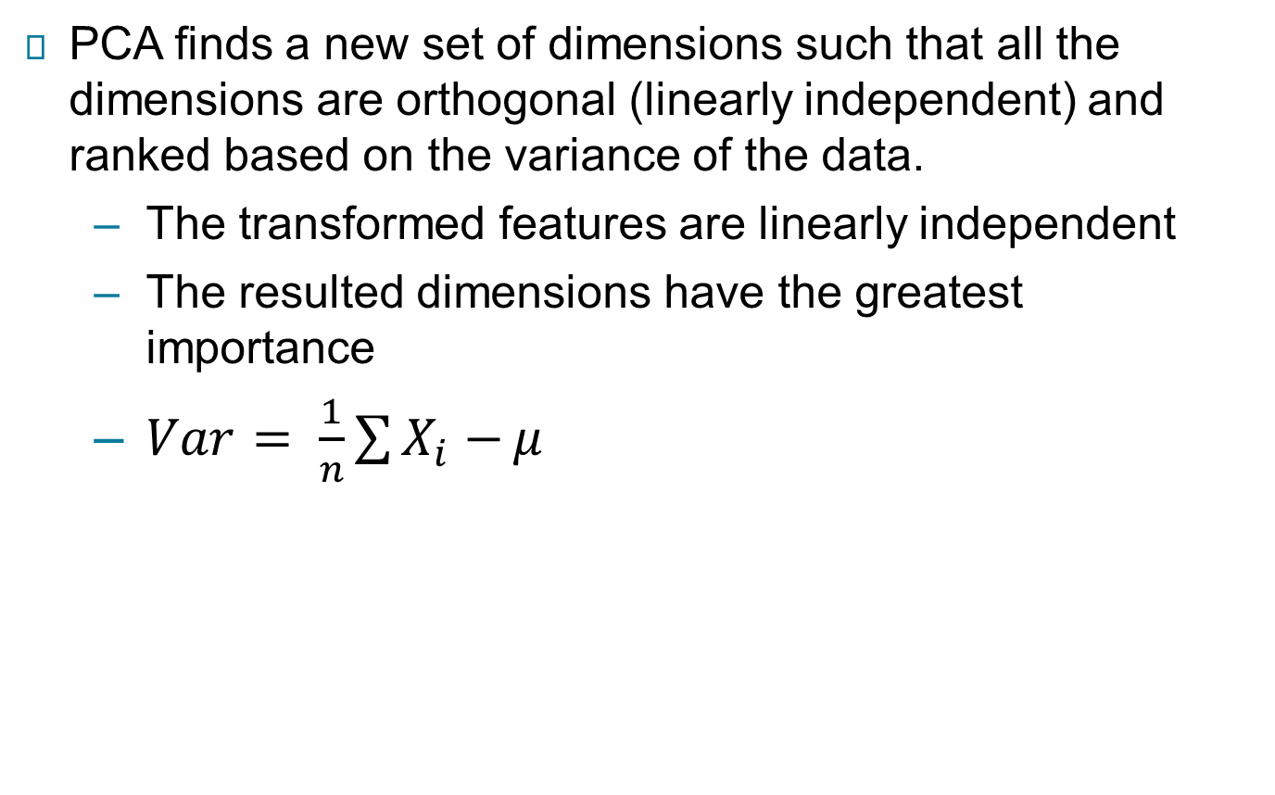
PCA

Slide 38
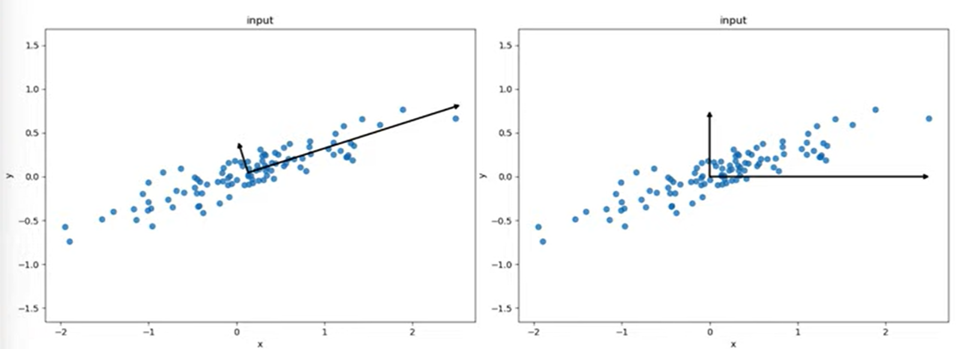
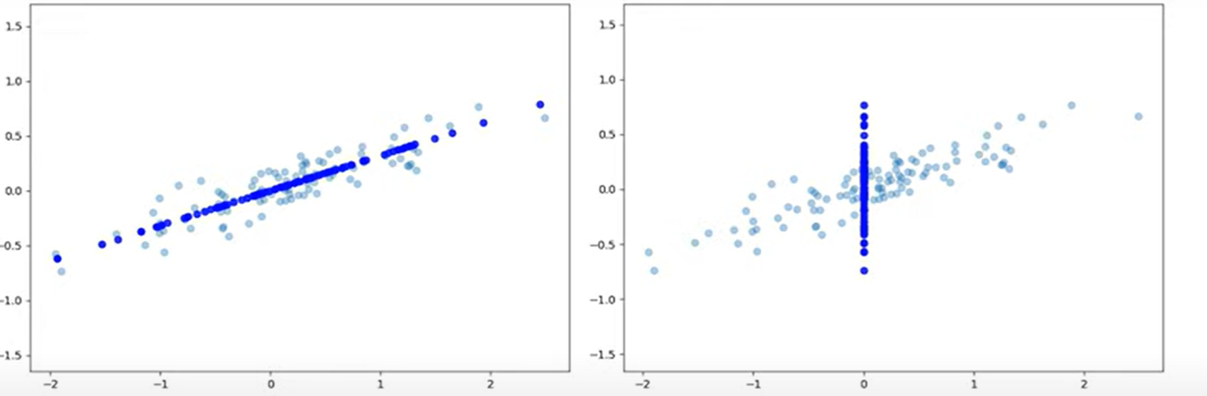

Slide 39
PCA algorithm
Calculate the covariance matrix of the variables in the dataset (the data should be centered at zero)
find the Eigenvectors and Eigenvalues
Sort Eigenvectors and Eigenvalues in a decreasing order
Choose the k Eigenvectors to reduce your data to k dimensions
Project the data onto the new space

Slide 40
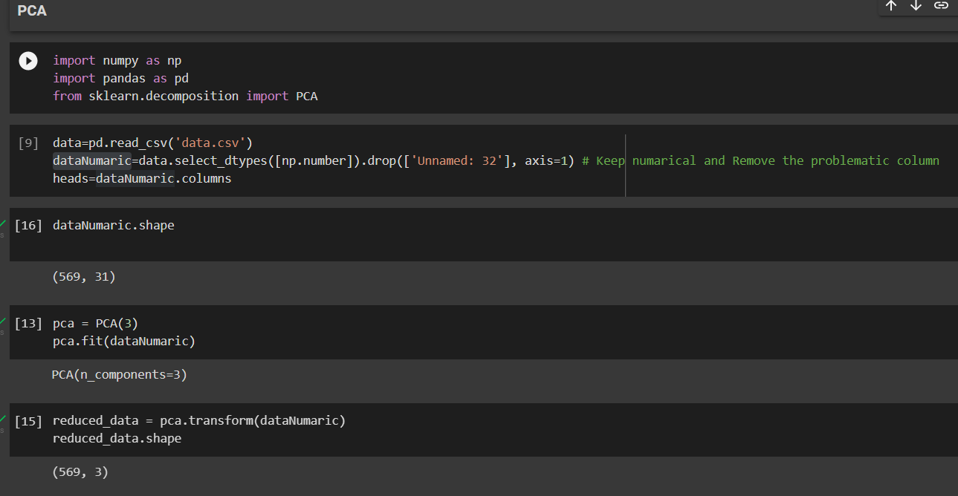
Using PCA in python

Slide 41
Feature selection
The process of removing the unwanted features (the features which are likely to reduce the performance of the system)
One method to use is called Variance-threshold, in which the features with low variance are eliminated.

Slide 42
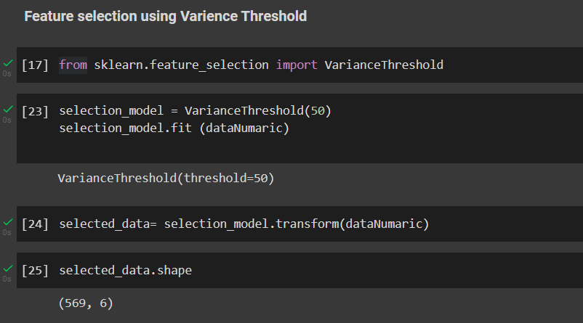
Variance-threshold in python

